Slide 1
Building Rockets
Skyline Rocketry Club

Slide 2
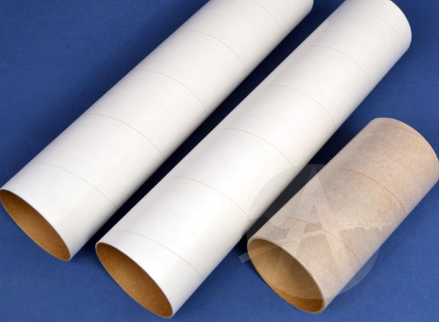
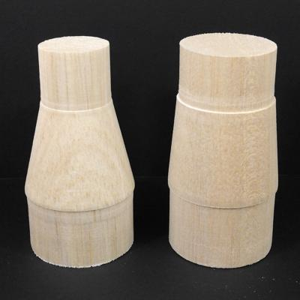
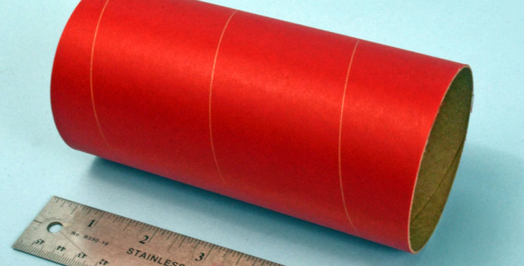
Body Tubes
Longer body tube -> More stability
Shorter body tube -> Less mass and drag
Couplers: Connect body tubes of the same size
Transitions: Connect body tubes of different sizes

Slide 3
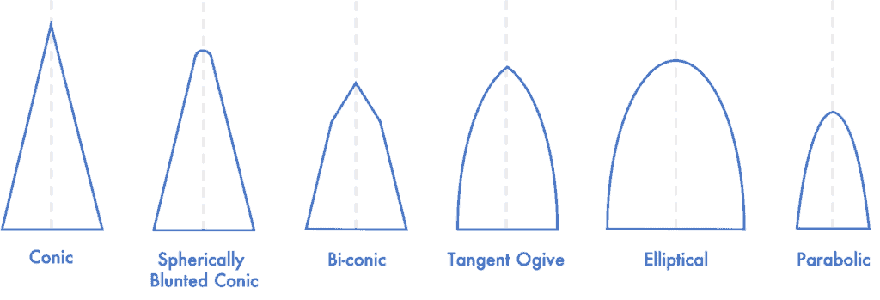
Nose cones
Sharp nose cones -> Effective at higher speeds, less aerodynamic
Round nose cones -> More efficient at lower speeds, more aerodynamic
Reference: https://themodelrocket.com/the-essential-guide-to-model-rocket-nose-cones/
Notes:
Round Nose cones: More aerodynamic (like planes)
Sharp nose cones: Faster lift off, more drag – Saturn V and others

Slide 4
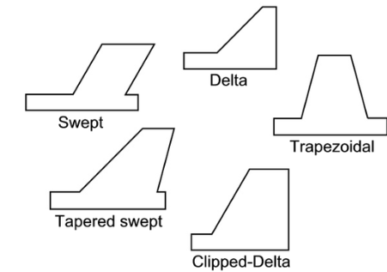
Fins
Fins stabilize the rocket and changes the center of pressure
A stable rocket has its center of gravity ahead of the center of pressure.
  This can be verified through rocket simulation software
3 fins: Less drag
4 fins: More stability
Leading edge can be altered for aerodynamics
  Wedge, rounded, chisel
Tube fins can be used for less weathercocking effects
*Wood fins should have the grain parallel to the leading edge
Resource: Model Rocket Fins 101

Slide 5
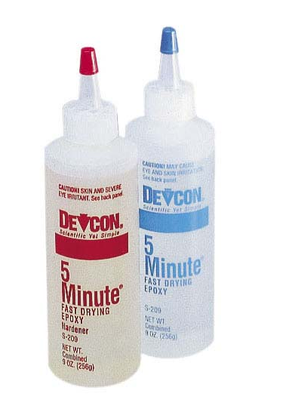
Epoxy
Used to attach and secure parts
Epoxy is a two-part adhesive – the epoxy resin and hardener
  These are mixed when ready to use
  The mixing ratio is dependent on the epoxy
Attaching components is done in two steps:
  First secure the part with 5 minute epoxy
  Once secured, apply 30 minute epoxy to solidify the connection

Slide 6
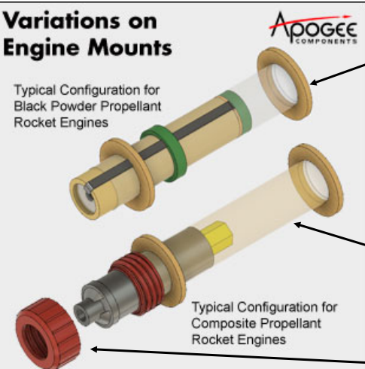
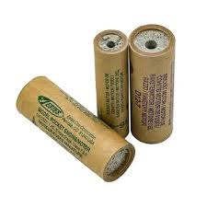
Motor Mounts and Altimeter Mounts
Mounts are rings usually made of wood to secure smaller-diameter components inside a body tube.
Motors have a mount at the bottom
Altimeters can be placed in a removable mount near the front of a rocket

Slide 7
Parachute
Parachutes are deployed based on a timed ejection charge in the motor
Ejection charge delay can be changed before the launch to optimize parachute deployment a little after apogee

Slide 8
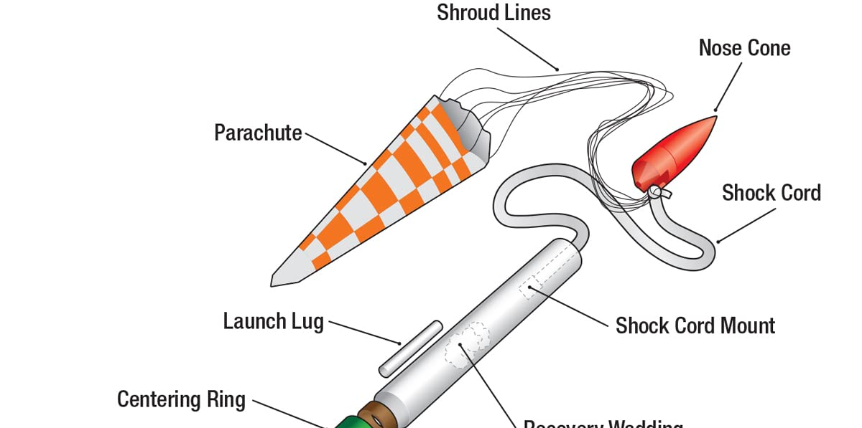
Shock cord
The shock cord connects the main body to the nose cone after parachute deployment.
Shock cords are usually made of elastic materials
The length of the shock cord is dependent on each rocket

Slide 9
Payload
The payload for the American Rocketry challenge is an egg
This year (2024) one egg is required
Eggs need to be intact on landing for a successful launch – this means protection is essential
Eggs can be placed in removable foam holders or pre-shaped egg holders.

Slide 10
Decoration
Decoration is important to the American Rocketry Challenge
Think of a cool design!

Slide 11
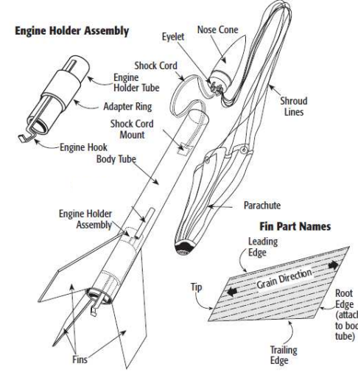
Full Rocket

